Slide 1

#Raho Ambitious
Named Entity Recognition
Instructor: Aditya Bhattacharya

Slide 2



Course : Machine Learning
Lecture On : Named Entity Recognition
Instructor : Aditya Bhattacharya

Slide 3

Agenda
What is NER?
Why we need it?
How does it works?
Open Source NER
Advantages of using SpaCy
Understanding SpaCy
Code Walkthrough
Q n A

Slide 4
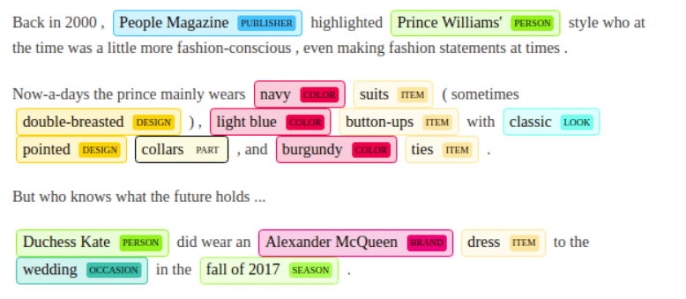
What is NER?
Named entity recognition is a natural language processing (NLP) technique that automatically identifies named entities in a text and classifies them into predefined categories.
Entities can be names of people, organizations, locations, times, quantities, monetary values, percentages, and more.

Slide 5
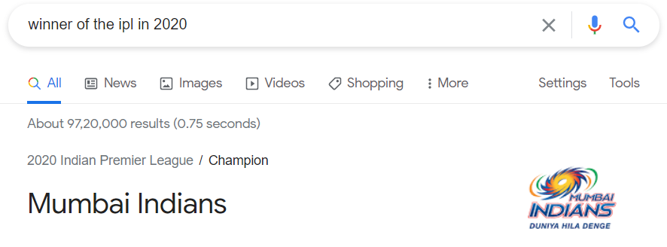
Why we need it?
We need NER for information extraction and to understand the context of a sentence.
Some of the popular use cases of NER are:
1) Chatbot
2) Content classification and Recommendation
3) Research Papers
4) Search Engine
5) Automatic reviewing of resume

Slide 6
How does it works?
As a human it is easy for us to recognize named entities like people, values, locations, and so on.
For example, in the sentence “Sundar Pichai is CEO of Google located in USA”
We can easily identify four types of entities:
“Person”: Sundar Pichai
“Designation” : CEO
“Organisation” : Google
“Country”: USA
But for computers we need to help them recognize entities first so that they can categorize them.
This is done through machine learning and Natural Language Processing (NLP).

Slide 7
How does it works?
NLP is used to read, decipher, understand, and make sense of the human languages in a manner that is valuable, while machine learning helps machines to learn and improve over time.
Hence we need to teach NER model which words are entities in a text and also to which category they belongs to.
So first, we need to create entity categories, like Name, Location, Event, Organization, etc or anything which suits your domain or use case and feed an NER model relevant training data. Then, by tagging some word and phrase samples with their corresponding entities, you’ll eventually teach your NER model how to detect and classify entities by itself.

Slide 8

Open Source for Python
Top 3 Open Source NER libraries are:
Stanford Named Entity Recognition (Implementation in JAVA but NLTK provides wrapper to use SNER in python)
NLTK (ne_chunk)
SpaCy
NLTK was created to support education and help students explore ideas.
While SpaCy is the most preferred library by app developers for NLP.

Slide 9
Advantages of SpaCy
SpaCy is preferred for Advanced Natural Language Processing in Python as it allows training with deep learning algorithms.
We can use more than 60 languages available for text processing such as English, Hindi, Spanish, German, French, Dutch. Mainly focus on industrial purpose.
It is designed specifically for production use and helps build applications that can process and understand large volumes of text.
It provides a default model which can recognize a wide range of named entities, which include person, organization, language, event etc.
SpaCy also gives us the liberty to add classes to the NER model, by training the model to update it with newer trained examples.

Slide 10
Understanding SpaCy
SpaCy divides itself into two parts:
spaCy’s Statistical Models
spaCy’s Processing Pipeline
spaCy’s Statistical Models
These models are the power engines of spaCy. These models enable spaCy to perform several NLP related tasks, such as part-of-speech tagging, named entity recognition, and dependency parsing.
Importing these models is super easy. We can import a model by just executing spacy.load(‘model_name’)

Slide 11
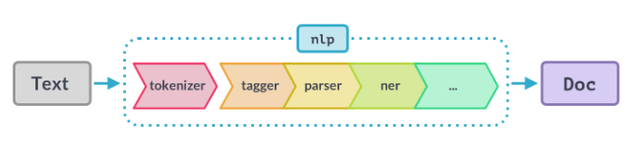
Understanding SpaCy
spaCy’s Processing Pipeline
The first step for a text string, when working with spaCy, is to pass it to an NLP object. This object is essentially a pipeline of several text pre-processing operations through which the input text string has to go through.
From above figure we can see that , the NLP pipeline has multiple components, such as tokenizer, tagger, parser, ner, etc. So, the input text string has to go through all these components before we can work on it.

Slide 12

Let’s see the code walkthrough now !

Slide 13
Thank You !

